Slide 1
bb
Sequence 3_ Time Value of Money_ Engineering Economics
Dr. Hassan Ashraf
Engineering Economics _ CU Islamabad _ Wah Campus _ Civil Engineering Department _ Session FA18

Slide 2
Time Value of Money
Winner of $ 25.6 Million Powerball Jackpot Claims Prize
The jackpot ( won by matching all five white balls in any order and the red Power ball) is either an annuitized prize paid out over 29 years or a lump sum payment. Each ticket costs $1. If the winner chooses the annuity, the annual payment will be increased each year by the percentage set out in the Powerball game rules. Freeman opted to take the one-time, lump sum payment of $13.5 million ( $ 13, 493, 470.86 before taxes, to be exact). It will take approximately two weeks to process the multistate prize payment.
If you were the winner of the aforementioned jackpot, you might well wonder why the value of the single-sum payment- $13.5 million paid immediately- is so much lower than the total value of the annuity payments- $25.6 million paid in 30 installments over 29 years (the first installment is paid immediately). Isn't receiving $25.6 million overall a lot better than receiving just $13.5 million now? The answer to your question involves the principles we will discuss in this chapter~ namely, the operation of interest and the time value of money.

Slide 3
Time Value of Money
The question we just posed provides a good starting point for this chapter. If
it is better to receive a dollar today than it is to receive a dollar in 10 years.
how do we quantify the difference?

Slide 4
Example illustrating the value of time
Pretend you have $100 and you want to buy a $100 refrigerator for your dorm room. ( Assume that you are currently sharing a large refrigerator with your roommates in a common area.)
If you buy it now, you end up broke. But if you invest your money at 6% annual interest, then in a year you can still buy the refrigerator, and you will have $6 left over. Clearly, you need to ask yourself whether the inconvenience of not having the refrigerator in your own room for a year can be compensated by the financial gain in the amount of $6.
If the price of the refrigerator increases at an annual rate of 8% due to inflation, then you will not have enough money ( you will be $2 short) to buy the refrigerator for a year from now ( Case 1 in Figure 2.1). In that case, you probably are better off buying the refrigerator now ( Case 1 in Figure 2.1). In that case, you probably are better off buying the refrigerator now. If the inflation rate is running at only 4%, then you will have $2 left over of you buy the refrigerator a year from now.

Slide 5
Example illustrating the value of time
Clearly, the rate at which you earn interest should be higher than the inflation rate in order to make any economic sense of the delayed purchase. In other words, in an inflationary economy, your purchasing power will continue to decrease as you further delay the purchase of the refrigerator. In order to make up for this future loss in purchasing power, the rate at which you earn interest must be sufficiently higher than the anticipated inflation rate. After all, time, like money, is a finite resource. There are only 24 hours in a day, so time has to be budgeted, too. What this example illustrates I that we must connect earning power and purchasing power to the concept of time.

Slide 6
Example illustrating the value of time
The way interest operates reflects the fact that money has time value. This is why amounts of interest depend on lengths of time; interest rates, for example, are typically given in terms of a percentage per year. We may define the principle of time value of money as follows: The economic value of a sum depends on when the sum is received. Because money has both earning power and purchasing power over time ( i.e., it can put to work, earning more money for its owner), a dollar received today has a higher value than a dollar received at some future time.

Slide 7
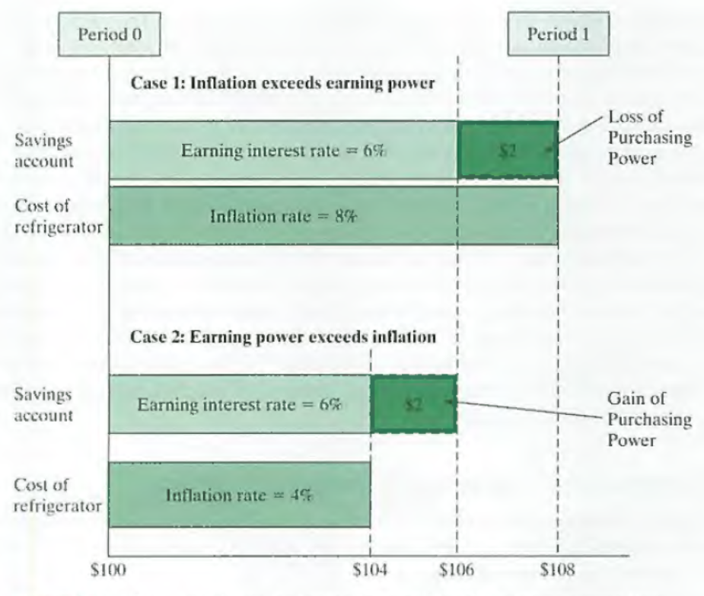
Time Value of Money
Gains achieved or losses incurred by delaying consumption

Slide 8
Cash Flow Diagram
Problems involving the time value of money can be conveniently represented in graphic form with a cash flow diagram. Cash flow diagrams represent time by a horizontal line marked off with the number of interest periods specified. Arrows represent the cash flows over time at relevant periods. Upward arrows represent positive flows (receipts), and downward arrows represent negative flows ( expenditures).
Arrows actually represent net cash flows. Two or more receipts or disbursements made at the same time are summed and shown as a single arrow. For example, $30,000 received during the same period as a $300 payment is being made would be recorded as an upward arrow of $29,700. The lengths of the arrows can also suggest the relative values of particular cash flows.

Slide 9
Cash Flow Diagram
Cash flow diagrams function in a manner similar to free-body diagram or circuit diagrams, which most engineers frequently use. Cash flow diagrams give a convenient summary of all the important elements of a problem and serve as a reference point for determining whether the elements of a problem have been converted into their appropriate parameters.
It is strongly encouraged to develop the habit of of using well-labelled cash flow diagrams as a means to identify and summarize pertinent information in a cash flow problem.

Slide 10
Cash Flow Diagram
End of Year | Receipts | Payments
 |  | Plan1 | Plan2
Year 0 | 30,000 | 300 | 300
Year 1 |  | 7,712.77 | 0
Year 2 |  | 7,712.77 | 0
Year 3 |  | 7,712.77 | 0
Year 4 |  | 7,712.77 | 0
Year 5 |  | 7,712.77 | 46,158

Slide 11
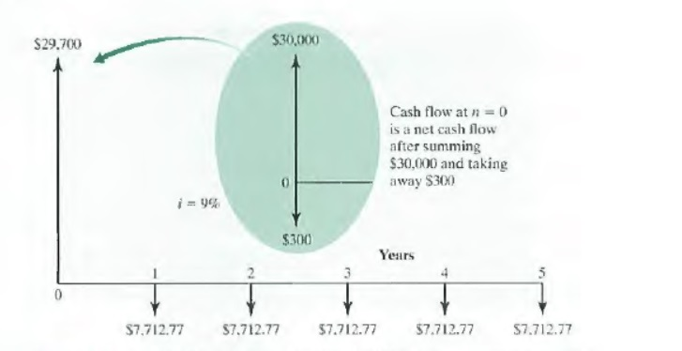
Cash Flow Diagram

Slide 12
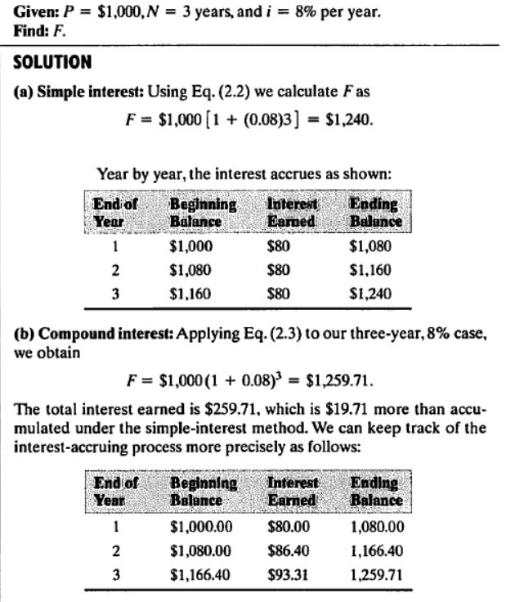
Simple Interest VS Compound Interest

Slide 13
Economic Equivalence
The observation that money has a time value leads us to an important question: If receiving $100 today is not the same as receiving $100 at any further point, how do we measure and compare various cash flows? How do we know, for example, whether we should prefer to have $20,000, today and $50,000 in 10 years from now, or $8,000 each year for the next 10 years?

Slide 14
Economic Equivalence
The central factor in deciding among alternative cash flows involves comparing their economic worth. This would be a simple matter if, in the comparison, we did not need to consider the time value of money. We could simply add up the individual payments within a cash flow, treating receipts as positive cash flows and payments ( disbursements ) as negative cash flows. The fact that money has a time value makes our calculations more complicated. Calculations for determining the economic effects of one or more cash flows are based on the concept of economic equivalence.

Slide 15
Economic Equivalence
Economic equivalence exists between cash flows that have the same economic effect and could therefore be traded for one another in the financial market place ( which we assume to exist). Economic equivalence refers to the fact that any cash flow – whether a single payment or a series of payments – can be converted to an equivalent cash flow at any point in time. The critical thinking on the present value of future cash flows is that the present sum is equivalent in value to the future cash flows because, if you had the present value today, you could transform it into the future cash flows because, if you had the present value today, you could transform it into the future cash flows simply by investing it at the interest rate, also referred to as the discount rate. This process is shown in the next slide.

Slide 16
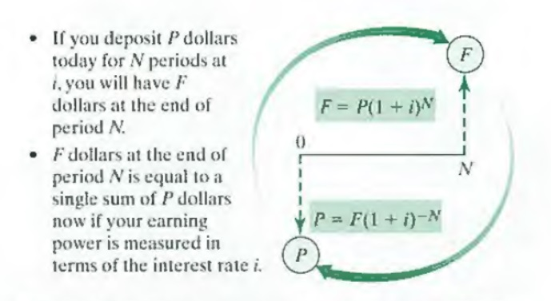
Using Compound Interest to establish Economic Equivalence

Slide 17
Using Compound Interest to establish Economic Equivalence
A way to see the concepts of equivalence and economic indifference at work in the real world is to note the variety of payment plans offered by lending institutions for consumer loans. Recall the table presented in slide # 10, where it was showed that two different repayment plans for a loan of $30,000 for five years at an annual interest rate of 9%. You will notice that the two plans require significantly different repayment patterns and different total amounts of repayment. However, because of the time value of money, these plans are equivalent – economically, the bank is indifferent to the consumer’s choice of plan.

Slide 18
Equivalence Calculations: A simple Example
Equivalence calculations can be viewed as an application of the compound-interest relationships we learned in section 2.1. Suppose, for example, that we invest $1000 at 12% annul interest for five years. The formula developed for calculating compound interest, F = P (1+i)^{N,} expresses the equivalence between some present amount P and a future amount F for a given interest rate i and number of interest periods, N. Therefore, at the end of the investment period, our sum grow to:
$1000 ( 1+0.12)⁵ = $ 1,762.34.
Thus, we can say that at 12% interest, $1000 received now is equivalent to $1,762.34 received in five years, and we could trade $1,000 now for the promise of receiving $ 1,762.34 in five years.

Slide 19
Equivalence Calculations: A simple Example
Suppose you are offered the alternative of receiving either $2,007 at the end of five years or $1,500 today. There is no question that the $2,007 will be paid in full (i.e., there is no risk of non receipt). Assuming that the money will not be needed in the next five years, you would deposit the $1,500 in an account that pays i% interest. What value of I would make you indifferent to your choice between $1,500 today and the promise of $2,007 at the end of five years?
Again going to back to the fundamental equation of compound interest
F = P ( 1+i)^{N} and solve it for i.
Given F = $2,007, N= 5 Years, P $,1500

Slide 20
Equivalence Calculations: A simple Example
Using the expression of Eq. (2.3) we obtain
$2,007 = $ 1,500 (1+i)⁵
Solving for I yields:
i= (F/P)^{1/N} -1 = (2,007/1,500)^{1/5} – 1= 0.06 ( or 6%)
W can summarize the problem graphically as in Figure

Slide 21
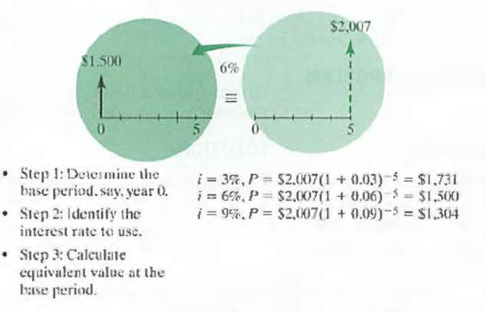
Equivalence Calculations: A simple Example

Slide 22
Equivalence Calculations: A simple Example
Comments: In this example, it is clear that if I is anything less than 6%, you would prefer the promise of $2,007 in five years to 1,500 today; if i is more than 6%, you would prefer $1,500 now. As you may have already guessed, at a lower interest rate, P must be higher in order to be equivalent to the future amount. For example, at i=4%, P= $ 1,650

Slide 23
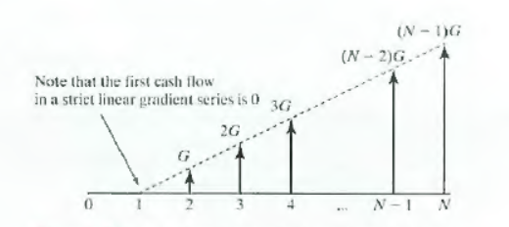
Equivalence Calculations: A simple Example
Handling Linear Gradient Series:
Sometimes, cash flows will increase or decrease by a set amount, G, the gradient amount. This type of series is known as a strict gradient series. Note in the below figure, that each payment is An = (n-1)G. Note also that the series begins with a zero cash flow at the end of the period1. If G>0, the series is referred to as an increasing gradient series. If G<0, it is referred to as a decreasing gradient series.

Slide 24
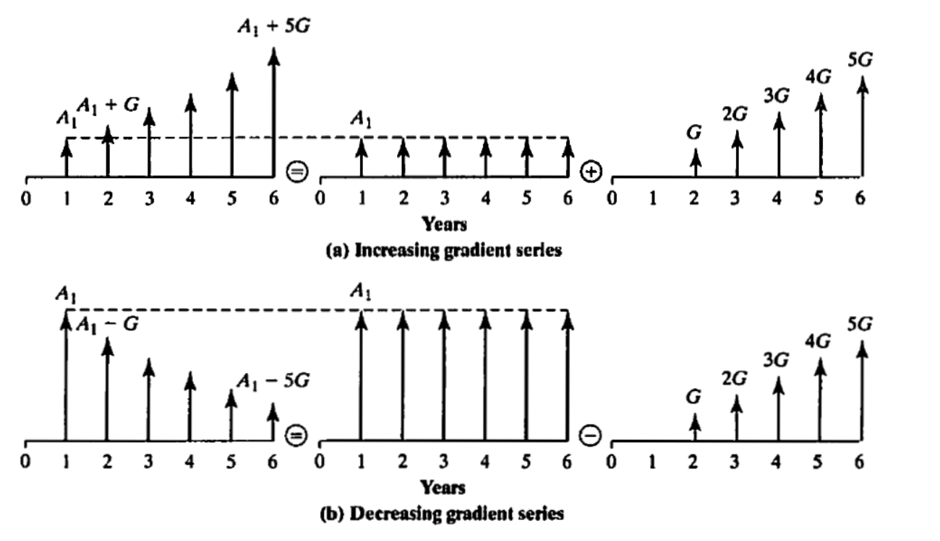
Equivalence Calculations: A simple Example

Slide 25
Equivalence Calculations: A simple Example
You borrowed 10,000 from a local bank with the agreement that you will pay back the loan according to a graduated payment plan. If your first payment is set at1,500, what would the remaining payment look like at a borrowing rate of 10% over five years?
Given P=10,000, A1=1,500, N=5 years, and i=10% per year. Find G.
Solution:
Since the loan payment series consists of two parts – (1) a 1,500 equal-payment series and (2) a strict gradient series (unknown, yet to be determined)- we can calculate the present value of each series and equate them with 10,000.
10,000= 1,500 (P/A,10%,5) + G(P/G,10%,5)
= 5,686.18 + 6.8618G
G= 628.67

Slide 26
Equivalence Calculations: A simple Example
Annual Payment Options
The winner would receive the jackpot in 26 graduated annual payments. In this case, the winner would receive $175,000 as the first payment (2.5% of the total jackpot amount) immediately. The second payment would be $189,000. Over the course of the next 25 years, these payments would gradually increase each year by$7,000 to a final payment of $357,000.
Given = A0 = 175,000 , A1= 189,0000, G=7,000 ( from payment periods 2 to 25), i=4.5% per year, and N=25 years, as shown in figure.

Slide 27
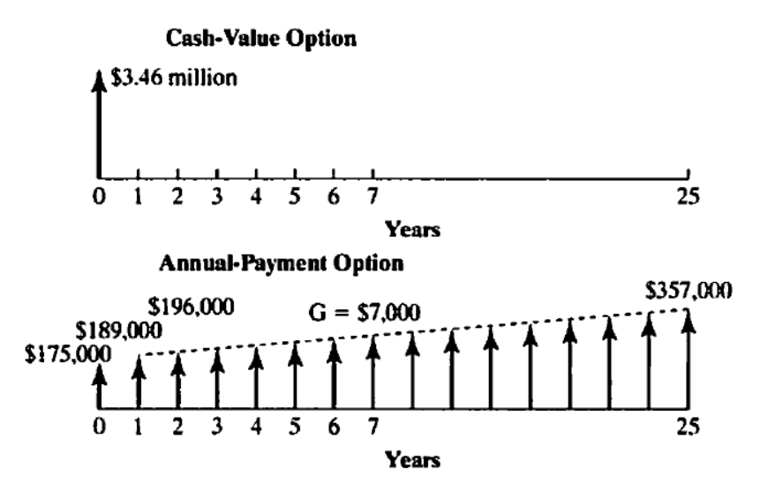
Equivalence Calculations: A simple Example

Slide 28
Equivalence Calculations: A simple Example
P= 175,000 + 189,000 (P/A. 4.5%,25) + 7000(P/G,4.5%,25)
= 3,990,189.

Slide 29
Geometric Gradient Series
Suppose that your retirement benefits during your first year of retirement are $50,000. Assume that this amount is just enough to meet your cost of living during the first year. However, your cost of living expected to increase at an annual rate of 5% due to inflation. Suppose you do not expect to receive any cost-of-living adjustment in your retirement pension. Then, some of your future cost of living has to come from savings other than retirement pension. If your savings account earns 7% interest a year, how much should you set aside in order to meet this future increase in the cost of living over 25 years?

Slide 30
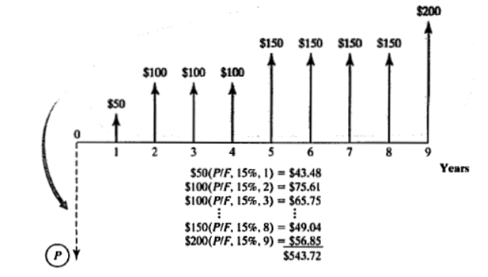
More on Equivalence Calculations

Slide 31
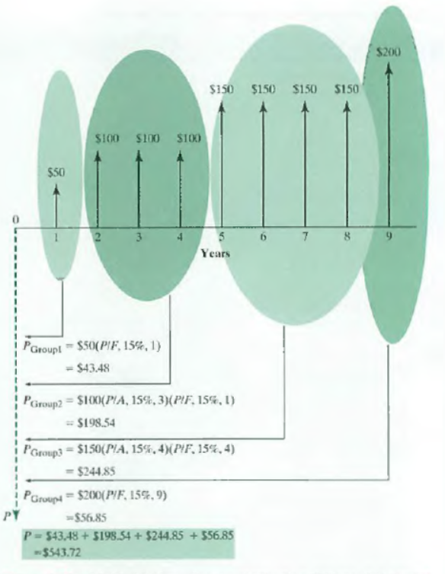
More on Equivalence Calculations

Slide 32
bb
Thank You

